Slide 1
Agentic Proposal Generator
An innovative use case for LLM in sales

Slide 2





Overview
Solution
Business problem:
Leading global hospitality brand is unable to respond to each lead quick enough with a personalized and detailed proposals
Leveraged the power of text-based LLMs to create high quality, and personalized content.
Implemented context-based image recommendation using image-to-text supportive LLMs.
Organized the flow of generating a proposal with multi model architecture using LangGraph (used for better flow control).
Optimized the application for cost, latency, and quality of content and recommendation.
“All that you have done is awesome - its a leap”
“[does] better than he would have as a seasoned seller”
Impact
"Its “friendly and inviting but not too casual” "
Average proposal generation time reduction: from 2 hours down to 2 minutes, a 98.3% time reduction.
Productivity increase: From 0.5 to 30 tasks/hour, a 60-fold increase.
97.33% reduction in cost per proposal
Strikes balance well and represents Hyatt "ethos" very well
VERY POSITIVE feedback from sellers and business leads on the language and tone/type of content for the AI generated content

Slide 3



Let’s plan an AI conference for Blend
Hotel
I would Like to host a corporate event. We are expecting to host around 500 employees.

Slide 4

Let’s plan an AI conference for Blend
Hotel
Thank you for considering us for your event. Let me get back to you with a proposal highlighting out services. Do you have any specific needs?

Slide 5

Let’s plan an AI conference for Blend
Hotel
Thank you for your patience. Here is our proposal. Please let me know if you have any questions.

Slide 6

Let’s plan an AI conference for Blend
Hotel
Oops! You took too long to reach back; I already booked another hotel. Sorry!! ..

Slide 7






Challenges with traditional system
High Cost
2 hours to generate 1 proposal
Lead Prioritization
Unable to reach out to all the leads.
Need lead prioritization
No Brand Voice
No Structural consistency
Brands tone change for each writer
1 proposal = $70

Slide 8
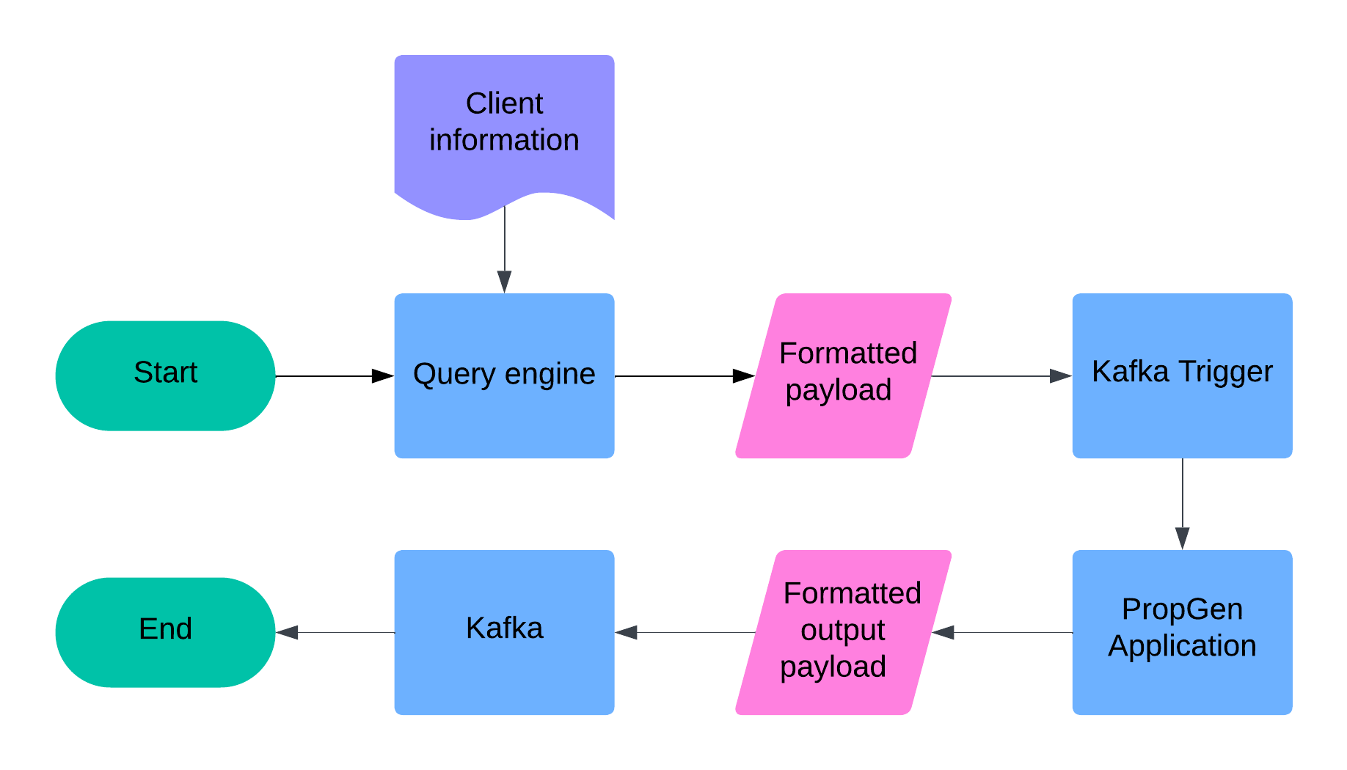
Implementation Overview

Slide 9
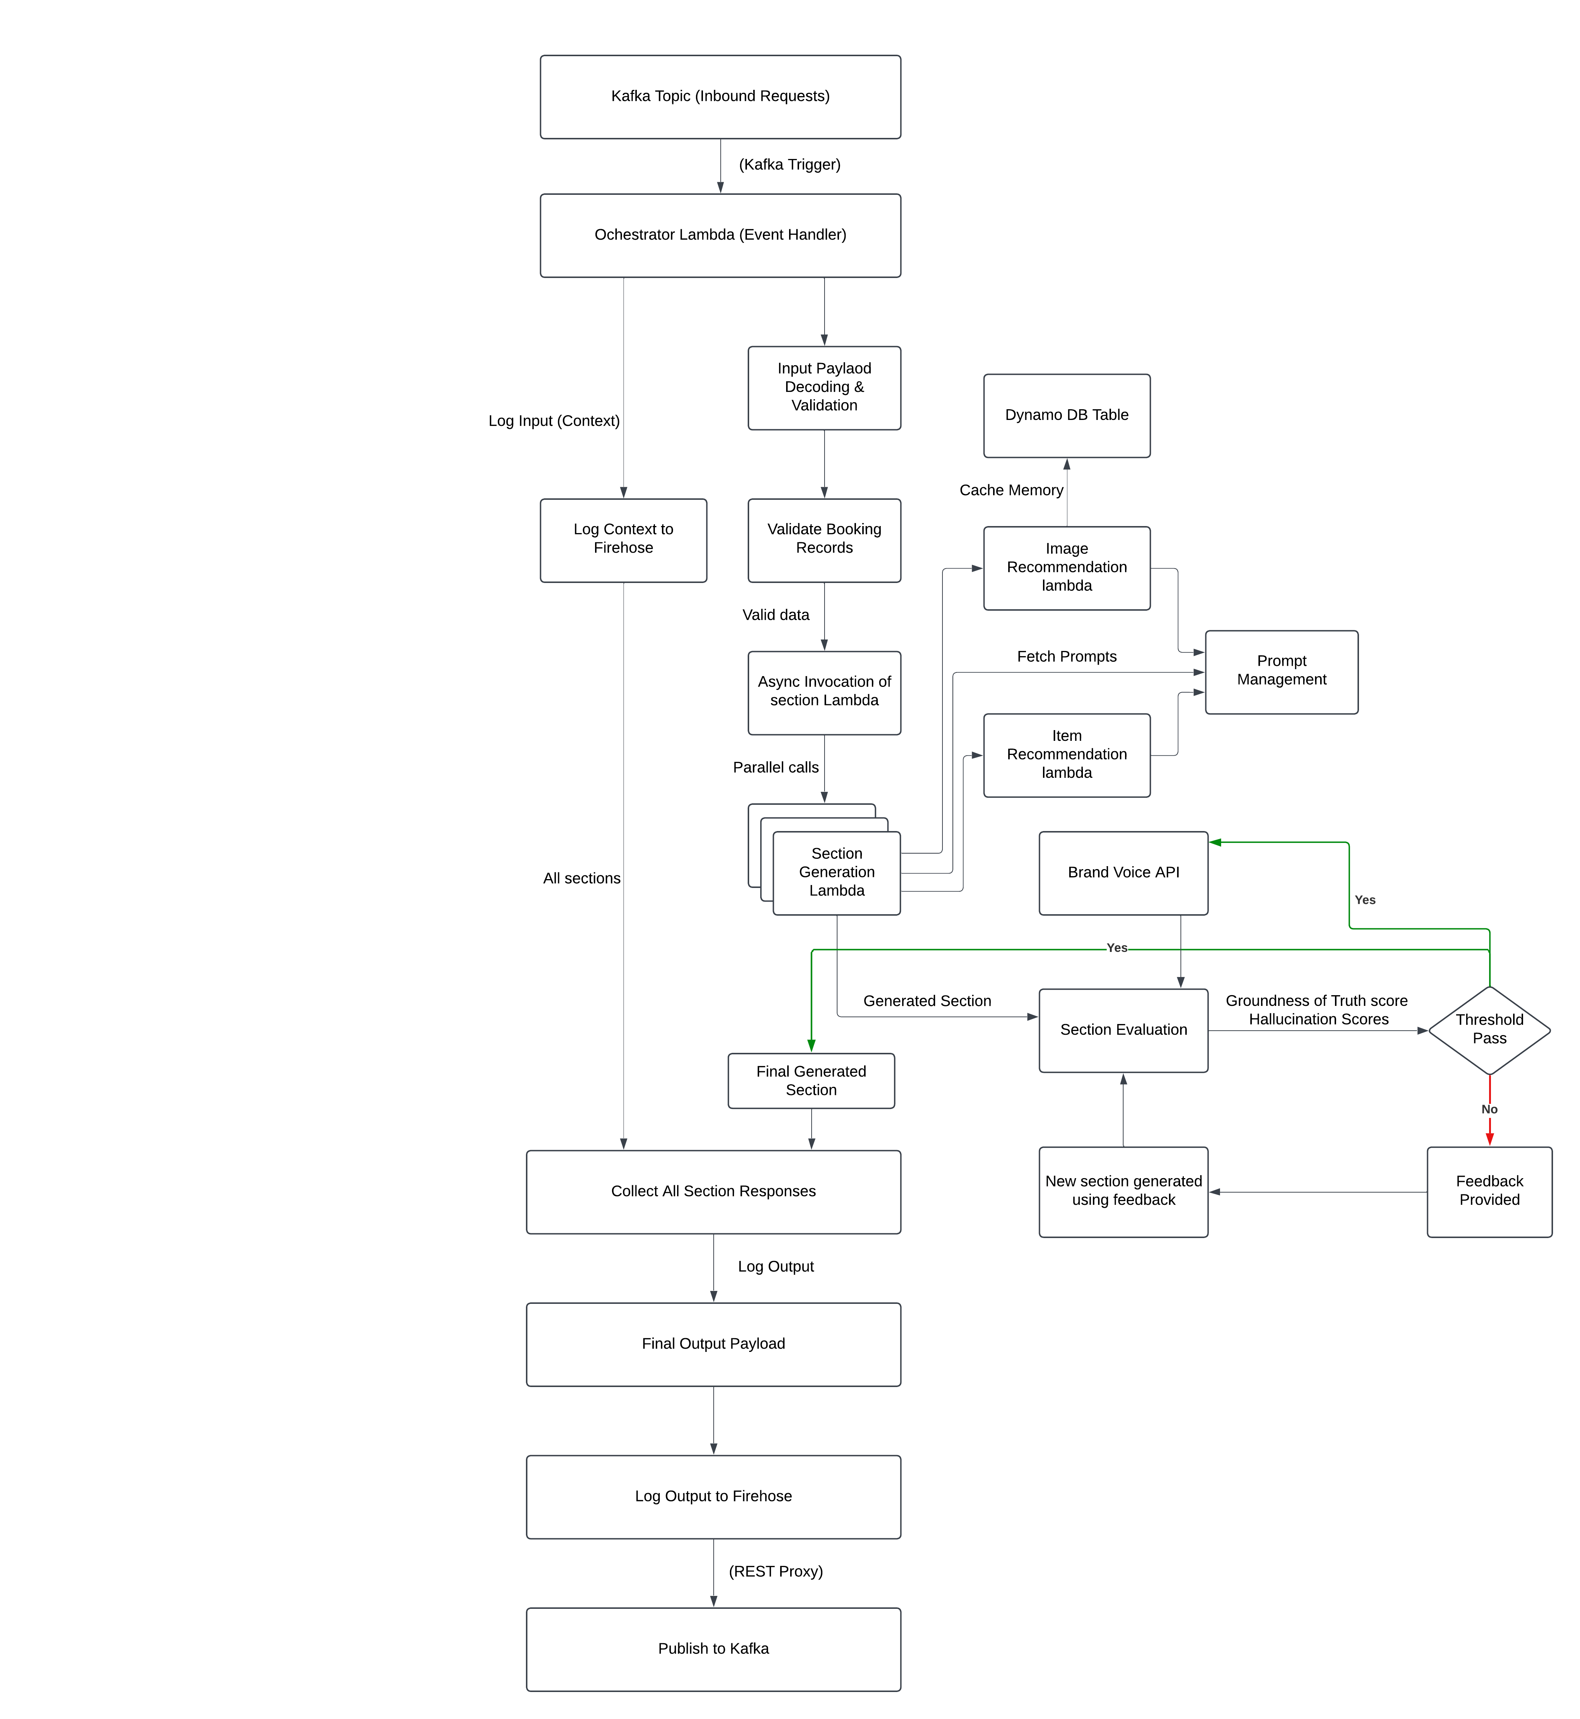
Detailed implementation

Slide 10
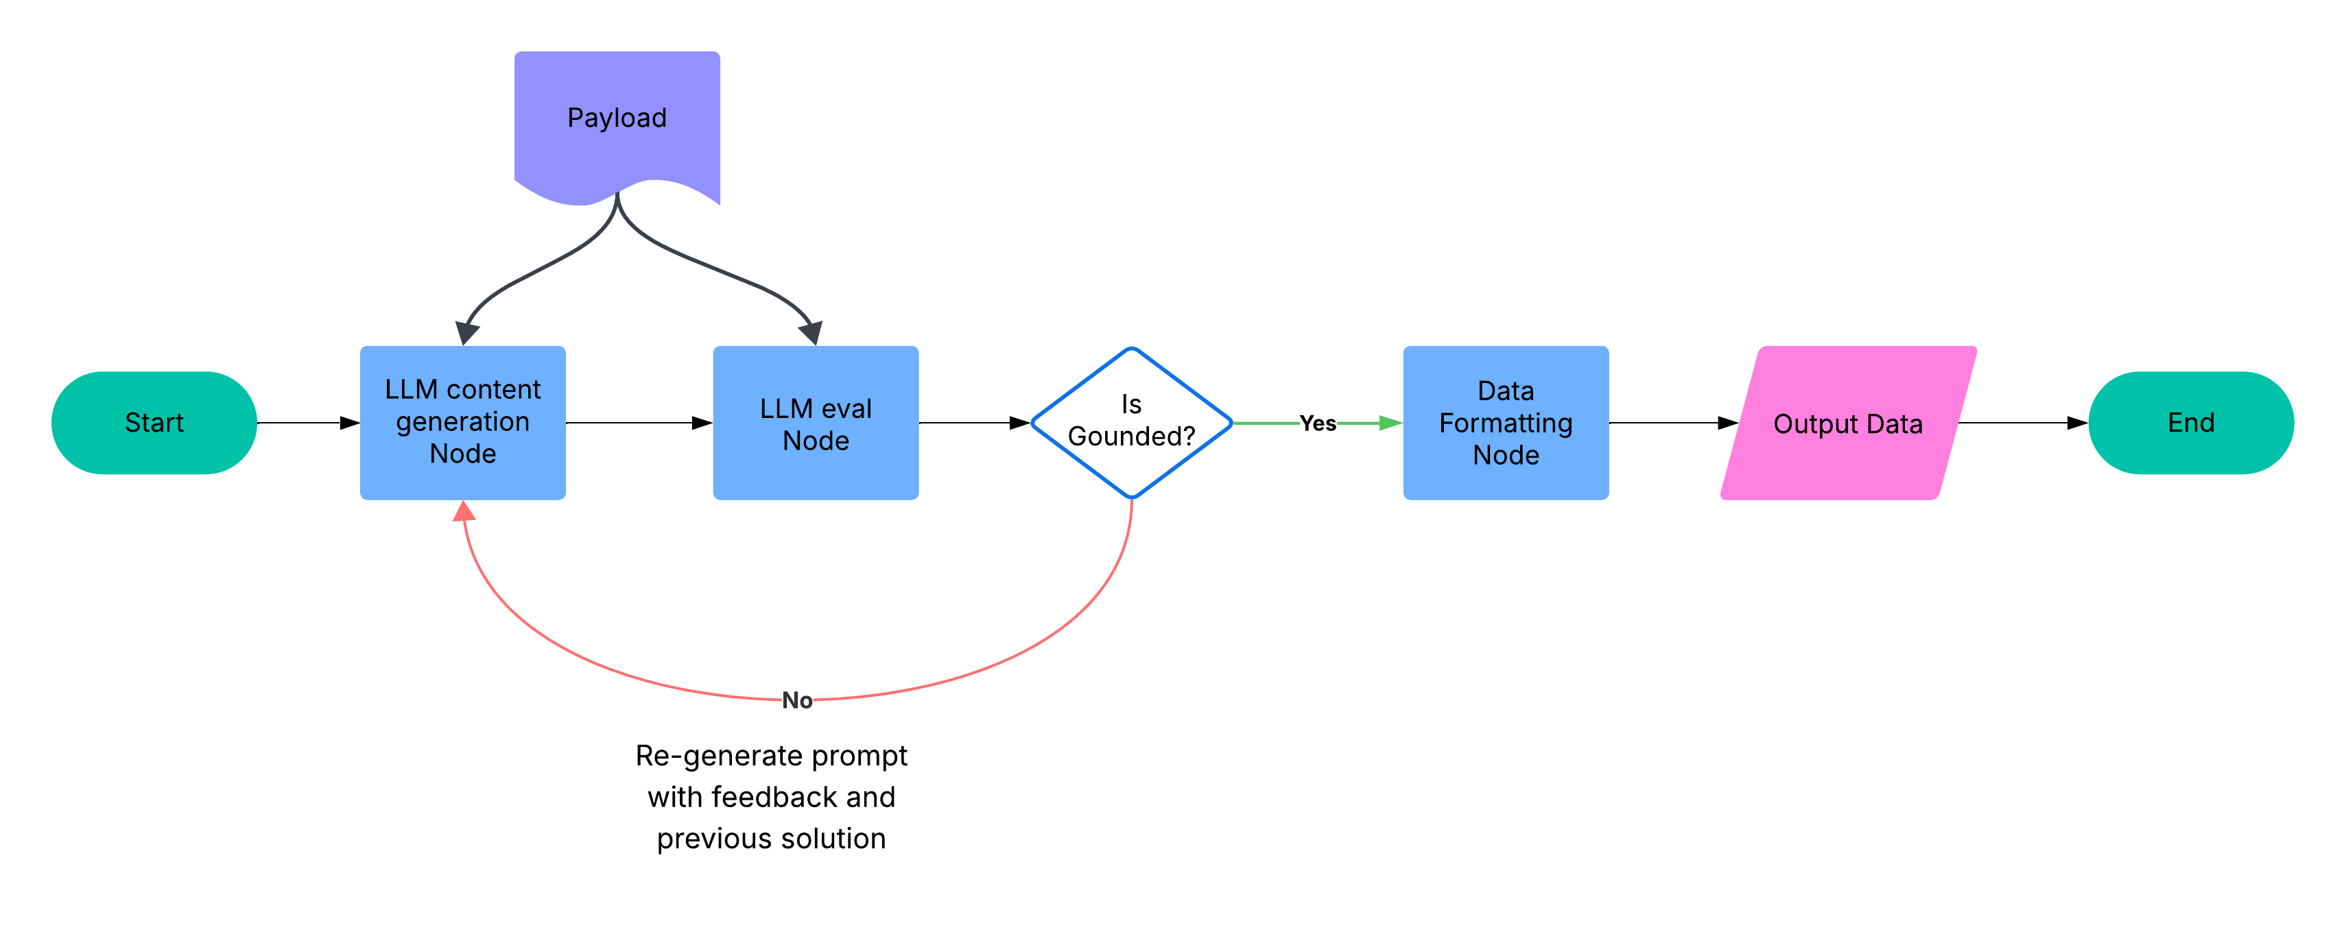
Why LangGraph?
Provided better flow control
Allowed conditional flow
Allowed looping implementation with added feedback from evaluator
Better code readability

Slide 11
Challenges with LLM based Application
Model Selection
Cost per million token
Latency (call to response time)
Infrastructure limitation
API calls per min
Token limits per min
Cross functional team Collaboration
No feedback on the product until it was delivered
Vague product requirements across teams
Response Quality Evaluation

Slide 12
Evaluating LLM performance
Ground Truth Score
Hallucination score
Latency
Input tokens
LLM cost / Proposal
Infra cost
Output tokens
Total token
LLM calls / proposal
Proposal execution time

Slide 13



Learnings
Questions to ask at the beginning:
Which platform are we using?
Is it equipped to host a LLM application?
Which LLM model to use?
What is the LLM call and token limitation?
Can it be scaled easily?
Most importantly … How much will it cost?
“Design like everything will fail. That’s when it works best.”
Modularize the code. LLM call should be separate, it will make model change easier.
Add tracing and observability
Quality checks: support the impact using quantifiable matrix.
LLM is generating better response .. But how much better?

Slide 14



Impact: A quick Math
1 property gets up to 5 leads per day
Matrix | Traditional system | PropGen
Generation time | ~ 2 hours | ~ 2 mins
Cost | ~ $70 | ~ $0.7
LLM token used |  | ~ 1 Million
Infra cost |  | ~ $0.3
Need Lead Prioritization
All details and sections present? | Maybe
Brand level voice & style maintained? | Maybe
We have 1500 property = 7500 leads per day
Traditional system:
Total work hours = 7500 x (2 x 60) = 900,000 Minutes
You need at least 2 sales representative per property to just create the content = 3000 employees.
Labor cost = 1x35/hr 3000 X 35 X 8 = $840,000/ day
Proposal Generator application:
Total work hours = 7500 x (2) = 15,000 Minutes
You need only 1 sales representative per property to just create the content = 1500 employees.
Labor cost = 1x35/hr 1500 X 35 X (2/60) = $1750/ day
LLM cost = 7500 x $0.7 = $5250 per day

Slide 15
Overview
Solution
Business problem:
Leading global hospitality brand is unable to respond to each lead quick enough with a personalized and detailed proposals
Leveraged the power of text-based LLMs to create high quality, and personalized content.
Implemented context-based image recommendation using image-to-text supportive LLMs.
Organized the flow of generating a proposal with multi model architecture using LangGraph (used for better flow control).
Optimized the application for cost, latency, and quality of content and recommendation.
“All that you have done is awesome - its a leap”
“[does] better than he would have as a seasoned seller”
Impact
"Its “friendly and inviting but not too casual” "
Average proposal generation time reduction: from 2 hours down to 2 minutes, a 98.3% time reduction.
Productivity increase: From 0.5 to 30 tasks/hour, a 60-fold increase.
97.33% reduction in cost per proposal
Strikes balance well and represents Hyatt "ethos" very well
VERY POSITIVE feedback from sellers and business leads on the language and tone/type of content for the AI generated content

